Slide 1
University of basra collage of nursing Collection of Blood Samples
By
Iman Hanash rahi

Slide 2
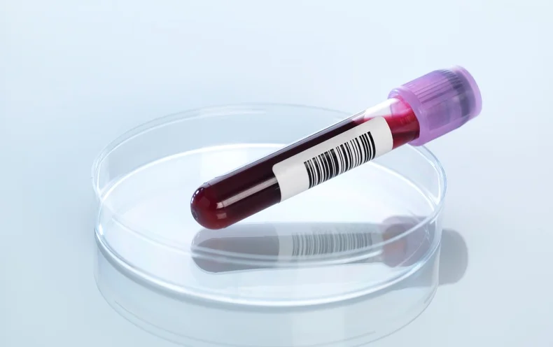
Introduction
Since blood is confined within the cardiovascular system, the skin has to be punctured before blood can be obtained.
There are two common sources of blood for routine laboratory tests:
blood from a superficial vein by puncturing it with a needle and syringe,
or from skin capillaries by skin-prick.
Arterial blood and blood from cardiac chambers may be required for special tests.

Slide 3
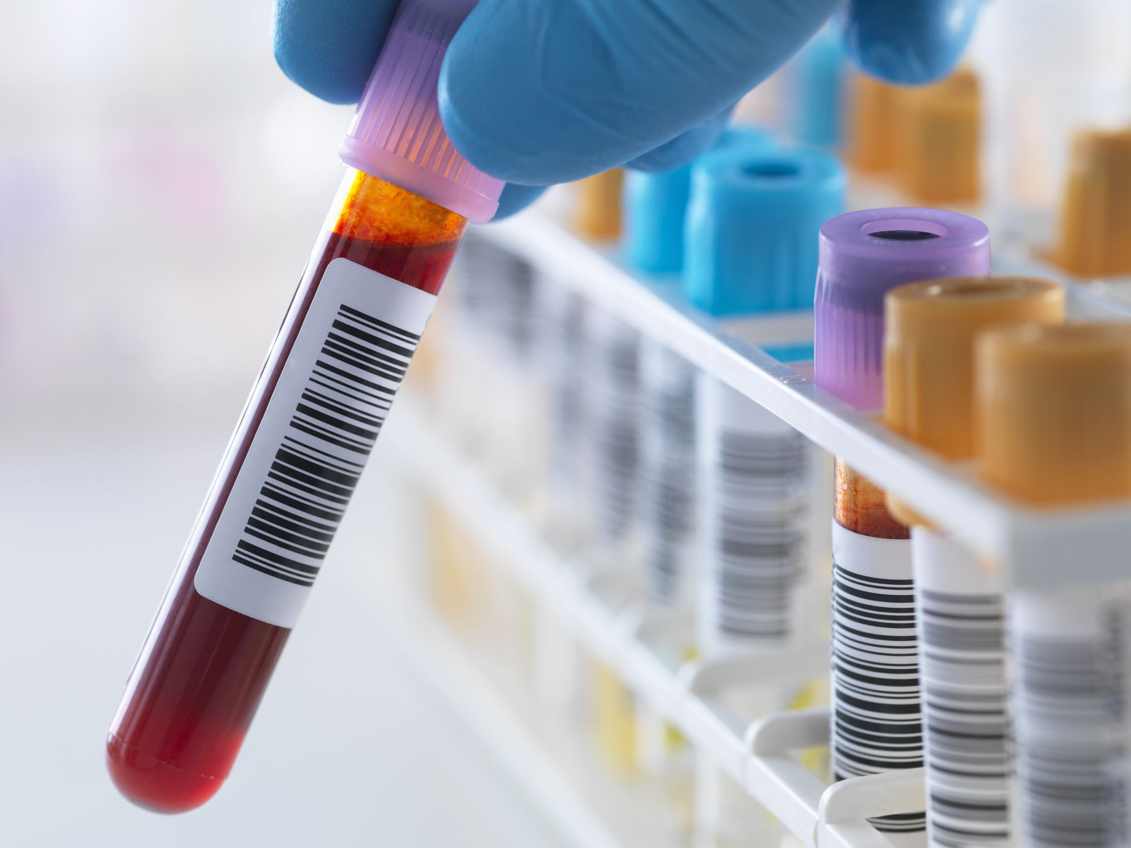
Introduction
None of these samples can be called a representative sample because there are minor variations in their composition.
But for routine hematological tests, however, these differences can safely be ignored

Slide 4
THE BLOOD SAMPLE
The term “blood sample” refers to the small amount of blood—a few drops or a few milliliters—obtained from a person for the purpose of testing or investigations.
These tests are carried out for aiding in diagnosis and/ or prognosis of the disease or disorder.

Slide 5
Sources and Amount of Blood Sample
Capillary blood.
Venous blood.
Arterial blood.
Cardiac catheterization.

Slide 6
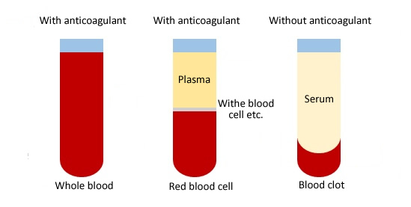
Containers for Blood Sample
A container may or may not contain an anticoagulant depending on whether a sample of blood/plasma, or serum is required.
For a sample of whole blood or plasma.
The blood is transferred to a container
containing a suitable anticoagulant.
This is to prevent clotting of blood.
For a sample of serum.
No anticoagulant is used.
The blood is allowed to clot in the container
and serum is collected.

Slide 7
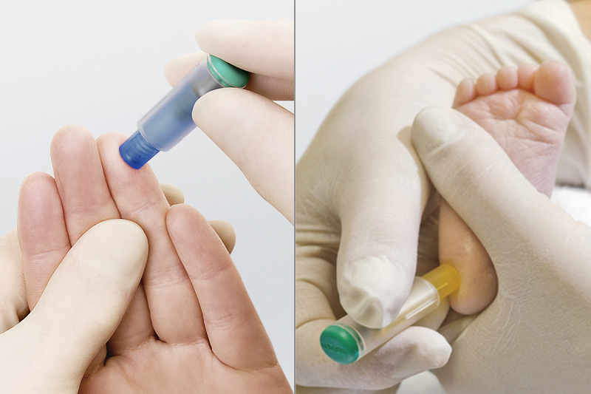
capillary blood does not require a container or anticoagulant

Slide 8
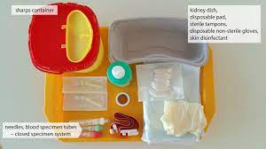
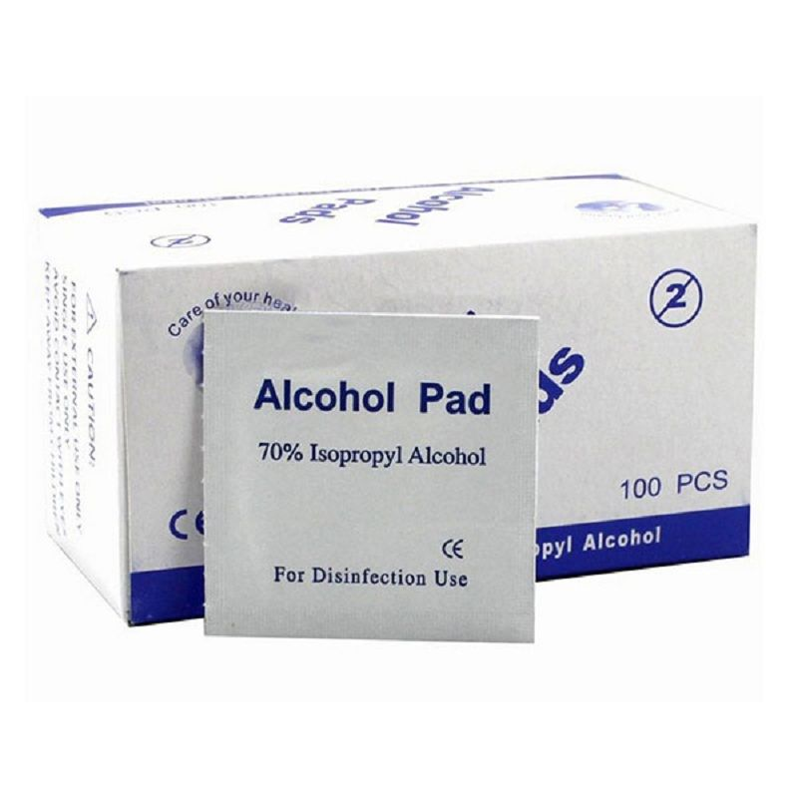
Asepsis
A. Sterilization of equipment
B. Cleaning/sterilizing of skin
C. Prevention of contamination.

Slide 9
What are the best puncture sites?

Slide 10
As shown in the figure above, suitable puncture sites are the sides of the fingertip, the earlobe and the heel.
Note: When puncturing the fingertip, it is important not to prick the centre of the fingertip, as the blood flow is weaker and it may be very painful for the patient. Likewise, the thumb is not recommended for capillary blood collection.
In infants, the puncturing of the fingertip should be avoided as it could damage the bone.
After puncturing, it is important that the initial drop of blood is discarded, as this consists largely of tissue fluid.

